Slide 1
QSS Query Serving Stack
July 2014

Slide 2
Overview
QSS is the part of Cassini takes a query and returns a list of matching items in rank order
The items are found using an index
The index lookup is done in parallel in Query Nodes (QN). They also rank the items
Parallelism is accomplished using Scatter Gather

Slide 3
This presentation
Overview
index, query node and scatter gather
Architecture
Query rewrites: e.g. ski ➔ ski or skis
Multiple targets for search: e.g. active, completed
Null & Low
If query returns 0 or only a few results, query is rewritten to get more results
Etc

Slide 4
This presentation
Overview
index, query node and scatter gather
Architecture
Query rewrites: e.g. ski ➔ ski OR skis
Multiple targets for search: e.g. active, completed
Null & Low
If query returns 0 or only a few results, query is rewritten to get more results
Etc

Slide 5
Using An Index
Familiar Example: Index of a book
each word has a list of pages
Item Index
Each word has a list of items
Item Titles
Item Index
blue
cotton
red 1,4
shirt
sweater 3,4
1 red shirt
2 blue cotton shirt
3 blue sweater
4 red cotton sweater

Slide 6
Using An Index (2)
Item Titles
Item Index
blue
cotton
red 1,4
shirt
sweater 3,4
1 red shirt
2 blue cotton shirt
3 blue sweater
4 red cotton sweater
The query red sweater returns item #4
red sweater ➔ red AND sweater
(1,4) & (3,4) ➔ 4: red cotton sweater

Slide 7
Query Node (QN)
A query node takes a query as input and gets the set of items matching the query
It uses an index to find the items
For each returned item, it computes a score
A higher score means a better match
On the search results page (SRP), items will be ranked by score
QN then returns the set of items, together with their score

Slide 8
Scatter Gather
The index is divided into pieces (shards)
The items are divided into k groups
Each index shard contains (essentially) all the index words
But only one group of items
Shard 1
Example with k=2 shards
Shard 2
blue 1,7,13,21
cotton 5,13
red 1,3,7,13
shirt
sweater 3,5,7
blue 2,4
cotton 2,6,10
red 2,4,10,22,24
shirt 4,6
sweater

Slide 9
Scatter Gather (II)
The query nodes are arranged in a grid
Each column corresponds to a shard
Rows are identical (for load balancing)
Shard 1
Shard 2
Shard 3
Shard 4
QN
QN
QN
QN
QN
QN
QN
QN
QN
QN
QN
QN
QN = query node
QN
QN
QN
QN
QN
QN

Slide 10
Scatter Gather (III)
Scatter: the query is distributed to one QN in each column
Query
QN
QN
QN
QN
QN
QN
QN
QN
QN
QN
QN
QN
QN
QN
QN
QN
QN
QN

Slide 11
Scatter Gather (IV)
Gather: the results are merged, sorted by score
Items ready to display on SRP
Merge
QN
QN
QN
QN
QN
QN
QN
QN
QN
QN
QN
QN
QN
QN
QN
QN
QN
QN

Slide 12
This presentation
Overview
index, query node and scatter gather
Architecture
Query rewrites: e.g. ski ➔ ski OR skis
Multiple targets for search: e.g. active, completed
Null & Low
If query returns 0 or only a few results, query is rewritten to get more results
Etc

Slide 13
QSS Architecture
Client
SLB
SIBE
TRS
MT
TLA
LLA
LLA
LLA
LLA
LLA
LLA
Active Items
Completed Items
DSBE

Slide 14
Explanation of Components

Slide 15
SLB: Software Load Balancer
Client
SLB
Client request is routed to least-loaded machine in SLB pool
SIBE
TRS
MT
TLA
LLA
LLA
LLA
LLA
LLA
LLA
Active Items
Completed Items
DSBE

Slide 16
SLB (2)
Client
SLB
SLB in turn routes request to least loaded machine in the TRS pool
SIBE
TRS
MT
Why doesn’t client go right to TRS?
Fan-out
Client can’t reliably route to more than about 6 machines
But TRS pool is bigger than that
TLA
LLA
LLA
LLA
LLA
LLA
LLA
Active Items
Completed Items
DSBE

Slide 17
TRS: Transformer
Transforms the query
Sample transformations:
SIBE
Expands query
E.g. ski ➔ ski or skis
SIBE = Search Intelligence Back End
Machine Translation (MT)
NKWNV
Auto Parts Fitment
E.g. Gran ➔ Model:Gran Torino
Client
SLB
SIBE
TRS
MT
NKWNV
TLA
LLA
LLA
LLA
LLA
LLA
LLA
Active Items
Completed Items
DSBE

Slide 18
TLA: Top Level Aggregator
Client
SLB
TRS routes transformed query to machine with lowest load in TLA pool
SIBE
TRS
MT
TLA
LLA
LLA
LLA
LLA
LLA
LLA
Active Items
Completed Items
DSBE

Slide 19
TLA (2)
Client
SLB
TLA selects a grid
Example: if the client is requesting the dom cat of a query, request is routed to DSBE
more on DSBE later
TRS
SIBE
TLA
LLA
LLA
LLA
LLA
LLA
LLA
LLA
LLA
Active Items
Completed Items
Active Items 120
DSBE

Slide 20
TLA (3)
Client
SLB
Once grid selected, TLA routes to least loaded LLA
TRS
SIBE
TLA
There are 2 copies of Active Item Grid (80 cols / 120 cols)
LLA
LLA
LLA
LLA
LLA
LLA
LLA
LLA
Active Items 80
Completed Items
Active Items 120
DSBE

Slide 21
LLA: Low Level Aggregator
Client
SLB
LLA routes to least loaded column in selected grid
TRS
SIBE
TLA
LLA
LLA
LLA
LLA
LLA
LLA
Active Items
Completed Items
DSBE

Slide 22
LLA
LLA
LLA
LLA
QN
QN
QN
QN
QN
QN
QN
QN
QN
QN
QN
QN
Grid
QN
QN
QN
QN
QN
QN

Slide 23
Aggregation
Client
SLB
Red Arrows
Results from each column returned to Client
LLA and TLA merge results (in sorted order)
TRS
SIBE
TLA
Why need TLA & LLA?
Grid might have 120 columns
Without LLA, TLA would have to merge 120 streams
LLA
LLA
LLA
LLA
LLA
LLA
Active Items
Completed Items
DSBE

Slide 24
This presentation
Overview
index, query node and scatter gather
Architecture
Query rewrites: e.g. ski ➔ ski OR skis
Multiple targets for search: e.g. active, completed
Null & Low
If query returns 0 or only a few results, query is rewritten to get more results
Multiple related queries
Return top 200 results
But also compute the total number of results
Query nodes need extra info for ranking
E.g. historical behavior of the query

Slide 25
Null and Low
Initial query sent to QNs
Result comes back to TRS
If there are very few results, the query is reformulated by the transformer and sent back down to the query nodes

Slide 26
Null and Low (II)
Suppose Q is the initial query
Then the new query is (Q searched against description) or KAND(Q, 2)
Returns both description match and KAND on titles

Slide 27
KAND
KAND(str, k) finds all strings t in the table/index so that t contains at least k terms that are also in str.
Example KAND(“sea turtle pillow pet”, 3) finds
t = Littlest Pet Shop Sea Turtle, Frog, Butterfly, Dragonfly
t = Coastal Sea Turtle Decorative Art Throw Pillow

Slide 28
This presentation
Overview
index, query node and scatter gather
Architecture
Query rewrites: e.g. ski ➔ ski OR skis
Multiple targets for search: e.g. active, completed
Null & Low
If query returns 0 or only a few results, query is rewritten to get more results
Multiple related queries
Return top 200 results
But also compute the total number of results
Query nodes need extra info for ranking
E.g. historical behavior of the query

Slide 29
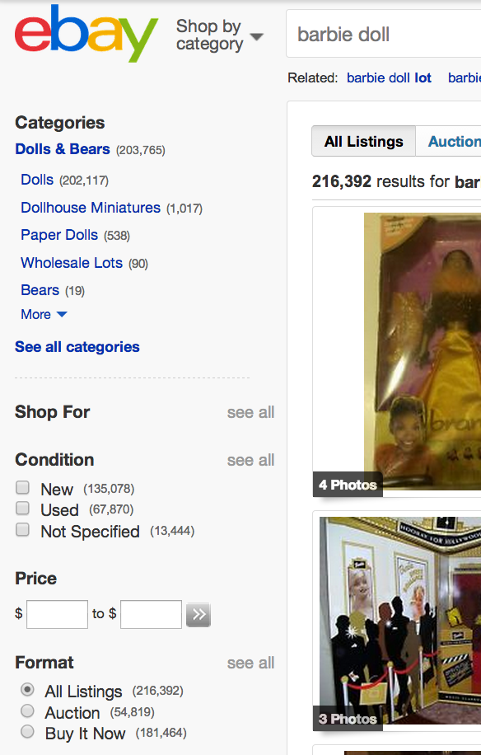
Left Rail
A separate query is used to obtain each set of numbers
Referred to as histogram

Slide 30
Subqueries
A query can have subqueries that use results of the main query
Example: client has query Q, wants both the top 50 items and the total number of results
Main query
Selects all items matching Q
Sorts by score, returns top 50
Subquery
Select all items matching Q
Returns count
This is cached
Reuse cached copy

Slide 31
eBay Query (actual xml)
8 subqueries
0 "output_fields":[{"term_reference":"COUNT",
"output_table_name":"ITEM.findItems.groupby.LH_ItemCondition#NotSpecifiedCountGb”,
1 "output_fields":[{"term_reference":"COUNT",
"output_table_name":"ITEM.findItems.groupby.prodRefId",
2 "output_fields":[{"term_reference":"COUNT",
"output_table_name":"ITEM.findItems.groupby.LH_ItemCondition#CountGroupby",
3 "output_fields":[{"term_reference":"COUNT",
"output_table_name":"ITEM.findItems.groupby.AUCTION",
4 "output_fields":[{"term_reference":"COUNT",
"output_table_name":"ITEM.findItems.groupby.ALL_CATS Histogram",
5 "output_fields":[{"term_reference":"COUNT",
"output_table_name":"ITEM.findItems.groupby.BIN",
6 "output_fields":[{"term_reference":"ParentID",
"output_table_name":"ot1_findItems",
7 "output_fields":[{"term_reference":"ParentID",
"output_table_name":"ot2_findItems”,
histograms
Auction/BIN (Buy It Now)
31

Slide 32
eBay Query (actual xml)
8 subqueries
0 "output_fields":[{"term_reference":"COUNT",
"output_table_name":"ITEM.findItems.groupby.LH_ItemCondition#NotSpecifiedCountGb”,
1 "output_fields":[{"term_reference":"COUNT",
"output_table_name":"ITEM.findItems.groupby.prodRefId",
2 "output_fields":[{"term_reference":"COUNT",
"output_table_name":"ITEM.findItems.groupby.LH_ItemCondition#CountGroupby",
3 "output_fields":[{"term_reference":"COUNT",
"output_table_name":"ITEM.findItems.groupby.AUCTION",
4 "output_fields":[{"term_reference":"COUNT",
"output_table_name":"ITEM.findItems.groupby.ALL_CATS Histogram",
5 "output_fields":[{"term_reference":"COUNT",
"output_table_name":"ITEM.findItems.groupby.BIN",
6 "output_fields":[{"term_reference":"ParentID",
"output_table_name":"ot1_findItems",
7 "output_fields":[{"term_reference":"ParentID",
"output_table_name":"ot2_findItems”,
histograms
Auction/BIN (Buy It Now)
32

Slide 33
Auction vs BIN
Auction items and BIN (Buy it Now) items ranked separately in QN
Separate subqueries (as on last slide)
Combined in TRS on the way up
Combined in a fixed ratio
E.g. if ratio is 2/3 then
BIN, BIN, Auction, BIN, BIN, Auction, BIN, BIN, ….

Slide 34
This presentation
Overview
index, query node and scatter gather
Architecture
Query rewrites: e.g. ski ➔ ski OR skis
Multiple targets for search: e.g. active, completed
Null & Low
If query returns 0 or only a few results, query is rewritten to get more results
Multiple related queries
Return top 200 results
But also compute the total number of results
Query nodes need extra info for ranking
E.g. historical behavior of the query

Slide 35
DSBE
Client
SLB
TRS has direct path to DSBE
Query nodes need DSBE info for ranking
Wasteful for each QN to connect to DSBE
So TRS does this once, and passed results down to QN
TRS
SIBE
TLA
LLA
LLA
LLA
LLA
LLA
LLA
Active Items
Completed Items
DSBE

Slide 36
DSBE (2)
Client
SLB
DSBE
Demand Service Back End
Contains info about a query
Examples
average historical recall size
Dom cat: category with most historical clicks
TRS
SIBE
TLA
LLA
LLA
LLA
LLA
LLA
LLA
Active Items
Completed Items
DSBE

Slide 39
Notes From Raffi
Why SLB: because the load balancer in library can only handle about 8 hosts, but TRS might have (say) 30
There is a separate Set of LLA for QN120, QN80,. Completed pool and DSBE. Choice between 120 and 80 made by load
The QN grid has two tables: item table and seller table
The TLA is the official path to DSBE. TRS has a ‘shortcut’ The TLA path is used when the client requests DSBE
A Cassini request can have independent queries. A query can have subqueries, i.e. (q, q1, q2, …). The subqueries assume that q has been run. For example q returns items, q1 is histogram. They share the ‘select’ part of the query.
TLA chooses a grid.
DSBE: when creating each entry is indexed by a query. But then SBE treats each query as a document, and builds an index for them. When you query the ‘documents’, you can use KAND. Associated with each document is the ‘blob’, the DSBE payload.
The index; no stop words.

